Slide 1

Tentative title: Special-Spectral Feature Extraction Based on Convolutional Neural Network for Hyperspectral Image Classification
Heaven’s Light is Our Guide
Rajshahi University of Engineering and Technology
Department of Computer Science & Engineering
Hasin Rehana Sadia Zaman Mishu
Roll no.: 133056 Lecturer
Department: CSE, RUET DepT. of CSE, RUET
Presented By Supervised By

Slide 2

Outline
Introduction
Motivation
Objectives
Literature Review
Proposed Method
Dataset
Implementation
Conclusion
Future work
References
25/03/18
Special-Spectral Feature Extraction for Hyperspectral Image Classification Based on Convolutional Neural Network

Slide 3
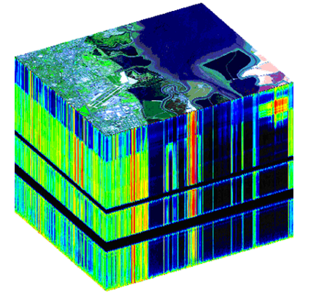
Introduction
Hyperspectral images have abundant of information stored in the various spectral bands ranging from visible to infrared region in the electromagnetic spectrum. So the main challenge of processing Hyperspectral Image is its high dimensionality. So its has been the area of interest for the researchers to reduce the dimensionality of HIS without losing important information so that learning algorithm can work efficiently on the dataset.
Figure: Hyperspectral image Cube
25/03/18

Slide 4

Motivation
Curse of high Dimensionality- A lot of features.
Extremely high cost and complexity of processing HSI
Relatively small number of images available to train the algorithm
Scope of using the advantage of the spatial relationships among the different spectra in a neighborhood
25/03/18
Special-Spectral Feature Extraction for Hyperspectral Image Classification Based on Convolutional Neural Network

Slide 5

Objectives
To study the basics of Hyperspectral Image
To study the basics of Feature extraction.
To learn about band selection techniques.
To implement Principal Component Analysis.
To learn the Implementation of Convolutional Neural Network.
To uphold a brief scheme about future work.
25/03/18
Special-Spectral Feature Extraction for Hyperspectral Image Classification Based on Convolutional Neural Network

Slide 6

Literature Review outline
Hyperspectral Image
Feature extraction
Principal Component Analysis
Convolutional Neural Network
Base paper 1
Base Paper 2
25/03/18
Special-Spectral Feature Extraction for Hyperspectral Image Classification Based on Convolutional Neural Network

Slide 7
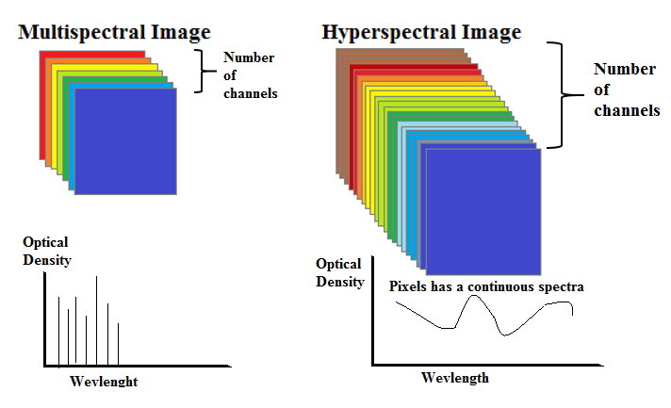
Hyperspectral Image
A Lot of spectral bands (100 and more).[1]
Resulting in a continuous spectra.
Figure: Multispectral Vs. Hyperspectral Image
25/03/18
Special-Spectral Feature Extraction for Hyperspectral Image Classification Based on Convolutional Neural Network

Slide 8
Feature extraction
A type of dimensionality reduction.
Efficiently represents interesting parts of an image as a compact feature vector
It is a process of deriving new features from the original features in order to reduce the cost of feature measurement, increase classifier efficiency, and allow higher classification accuracy.
Algorithms for feature extraction:
Principal Component Analysis
Kernel PCA
Histogram of oriented gradients (HOG)
25/03/18
Special-Spectral Feature Extraction for Hyperspectral Image Classification Based on Convolutional Neural Network

Slide 9
Literature Review (Deep feature Extraction and Classification of Hyperspectral Image Based on Convolutional Neural Network[2])
Dataset:
Indian Pines Dataset
University of Pavia Dataset
KSC dataset
Feature extraction architectures:
Spatial feature
Spectral feature
Spatial-Spectral feature
Algorithms:
CNN
L2 regularization
Logistic Regression
25/03/18
Special-Spectral Feature Extraction for Hyperspectral Image Classification Based on Convolutional Neural Network

Slide 10
Literature Review ( Spectral–Spatial Feature Extraction for Hyperspectral Image Classification: A Dimension Reduction and Deep Learning Approach[3])
Methodology:
Balanced Linear Discriminant Analysis (BLDE) is used to extract low-dimensionality spectral features from the original HSI data sets. To overcome this singularity problem the original data is transformed to a PCA subspace.
Second, high-level spatial features are extracted by a CNN framework.
Finally, both spectral and spatial features are stacked together, and an LR classifier is trained for classification.
25/03/18
Special-Spectral Feature Extraction for Hyperspectral Image Classification Based on Convolutional Neural Network

Slide 11
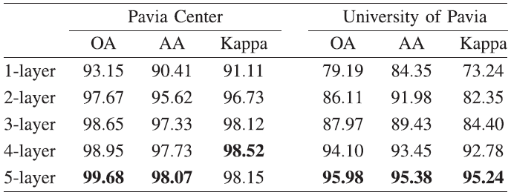
Literature Review ( Spectral–Spatial Feature Extraction for Hyperspectral Image Classification: A Dimension Reduction and Deep Learning Approach[3])
Experimental Accuracy[2]:
25/03/18
Special-Spectral Feature Extraction for Hyperspectral Image Classification Based on Convolutional Neural Network

Slide 12
Literature Review ( Spectral–Spatial Feature Extraction for Hyperspectral Image Classification: A Dimension Reduction and Deep Learning Approach[3])
Limitations:
How to set the size of training samples P is a key aspect in DL-based methods, which has not been considered in the current framework yet.
It is difficult to interpret the significance of CNN features for possible improvements in the future.
How to select the optimal observation scale in order to obtain the best classification accuracies for SSFC is a potential scope of this paper.
25/03/18
Special-Spectral Feature Extraction for Hyperspectral Image Classification Based on Convolutional Neural Network

Slide 13
Proposed Method
Hyperspectral Image
PCA
PC Components
CNN Framework
Deep features
Pixel Vector
Spectral Features
Classifier
Classification Result
25/03/18
Special-Spectral Feature Extraction for Hyperspectral Image Classification Based on Convolutional Neural Network

Slide 14
Available Dataset[4][5]
Dataset | Size | Sensor | Wevlength Range
Indiana Pine Dataset | 145x145x224 |  | 0.4-2.510
University of Pavia Dataset | 610x340x103
Pavia Center Dataset | 1096x715x1
KSC dataset
Washington DC Shopping Mall
25/03/18
Special-Spectral Feature Extraction for Hyperspectral Image Classification Based on Convolutional Neural Network

Slide 15
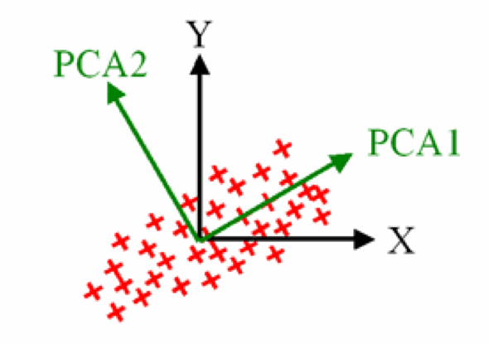
Principal Component Analysis
A statistical technique used to emphasize variation and bring out strong patterns in a dataset[6].
Forms a smaller set of uncorrelated features.
Useful for reducing dimensionality without much loss of information.
Often used to make data easy to explore and visualize.
Fig. Principal Component Analysis.
25/03/18
Special-Spectral Feature Extraction for Hyperspectral Image Classification Based on Convolutional Neural Network

Slide 16
Principal Component Analysis (Contd.)
Properties of PCA:
Maximizing the variance
Orthogonality of basis
Dimension reduction
Applications of PCA:
Risk management of interest rate derivatives portfolios
A variant of principal components analysis is used in neuroscience
25/03/18
Special-Spectral Feature Extraction for Hyperspectral Image Classification Based on Convolutional Neural Network

Slide 17
Principal Component Analysis (Contd.)
Limitations of PCA:
Principal components are usually linear combinations of all input variables.
Doesn’t emphasize individual classes during eigen analysiss.
Some of the important features may be lost.
PCA doesn’t guarantee that the selected features are the best for class separation.
25/03/18
Special-Spectral Feature Extraction for Hyperspectral Image Classification Based on Convolutional Neural Network

Slide 18
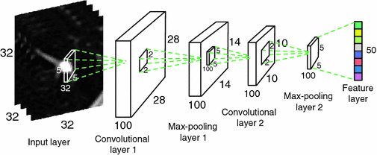
Convolutional Neural Network
Usually called CNN or ConvNet
A class of deep, feed-forward artificial neural networks.
Successfully being applied to analyzing visual imagery.
Layers:
Convolutional Layer
Pooling Layer
Fully connected Layer.
ReLU:
Non-linearity function.
Fig. : Visualization of CNN for FE
25/03/18
Special-Spectral Feature Extraction for Hyperspectral Image Classification Based on Convolutional Neural Network

Slide 19
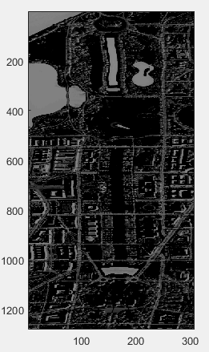
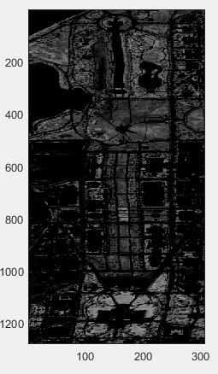
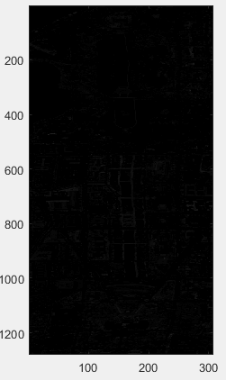
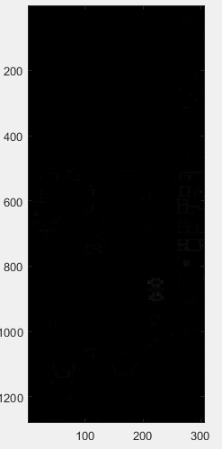
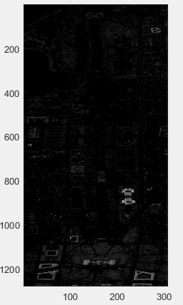
Implementation of PCA (Washington DC Shopping Mall dataset[5])
PC1 PC2 PC3 PC4 PC5
25/03/18
Special-Spectral Feature Extraction for Hyperspectral Image Classification Based on Convolutional Neural Network

Slide 20
Conclusion
PCA has been widely used in pattern recognition and remote sensing application for reducing dimensionality. But PCA doesn’t emphasize individual classes during eigen analysis resulting in loss of some of the important features. So it is needed to be followed by some other feature extraction and feature reduction techniques to get better result.
25/03/18
Special-Spectral Feature Extraction for Hyperspectral Image Classification Based on Convolutional Neural Network

Slide 21

Future works
Spatial Feature Extraction
Spectral Feature Extraction
Generate Spatial-Spectral Feature using feature fusion technique.
Application of Classification on the new feature set
Comparison of the efficiency with the existing methods.
25/03/18
Special-Spectral Feature Extraction for Hyperspectral Image Classification Based on Convolutional Neural Network

Slide 22

References
[1] John, A.R. and Xiuping, J., 2006. Remote sensing digital image analysis. New York: Springer-Verlag Berlin Heidelberg, p.55.
[2] Chen, Y., Jiang, H., Li, C., Jia, X. and Ghamisi, P., 2016. Deep feature extraction and classification of hyperspectral images based on convolutional neural networks. IEEE Transactions on Geoscience and Remote Sensing, 54(10), pp.6232-6251.
[3] Zhao, W. and Du, S., 2016. Spectral–spatial feature extraction for hyperspectral image classification: A dimension reduction and deep learning approach. IEEE Transactions on Geoscience and Remote Sensing, 54(8), pp.4544-4554.
[4] D. A. Landgrebe. [Online]. Available: “https://ngineering.purdue. edu/~biehl/MultiSpec/hyperspectral.html”.
25/03/18
Special-Spectral Feature Extraction for Hyperspectral Image Classification Based on Convolutional Neural Network

Slide 23
References
[5] D. Manuel, [Online] Available: http://www.ehu.eus/ ccwintco/index.php/ Hyperspectral_Remote_Sensing_Scenes
[6] Abdi, H. and Williams, L.J., 2010. Principal component analysis. Wiley interdisciplinary reviews: computational statistics, 2(4), pp.433-459.
Makantasis, K., Karantzalos, K., Doulamis, A. and Doulamis, N., 2015, July. Deep supervised learning for hyperspectral data classification through convolutional neural networks. In Geoscience and Remote Sensing Symposium (IGARSS), 2015 IEEE International (pp. 4959-4962). IEEE.
25/03/18
Special-Spectral Feature Extraction for Hyperspectral Image Classification Based on Convolutional Neural Network

Slide 24
References
Hossain, M.A., Jia, X. and Pickering, M., 2014. Subspace detection using a mutual information measure for hyperspectral image classification. IEEE Geoscience and Remote Sensing Letters, 11(2), pp.424-428.
25/03/18
Special-Spectral Feature Extraction for Hyperspectral Image Classification Based on Convolutional Neural Network

Slide 25

Thank You Any Question??
25/03/18
Special-Spectral Feature Extraction for Hyperspectral Image Classification Based on Convolutional Neural Network

